Slide 1
Politics and Household Income
A look across the states from 1984 to 2016

Slide 2

H0: There is NOT a connection between a state’s votes and median household income
HA: There is a connection between a state’s vote and median household income
a = 0.05

Slide 3
The Data
Median Income data came from US Census
1984 - 2019
State Votes’ came from Harvard Dataverse
1976-2016
Data is adjusted for inflation
20XX | 20XX | 20XX | 20XX

Slide 4
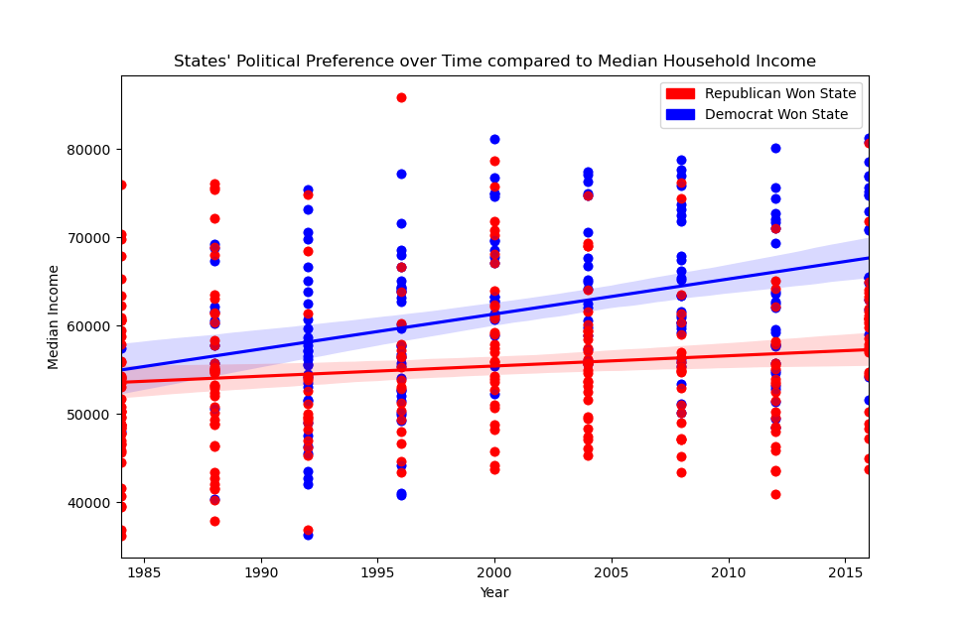

Slide 5

US Census data usually comes in csv but this one was ods at the time of extracting
US Census data was with headers, footers, inconsistencies, and adjusted for inflation values values
Problems
With
Data

Slide 6
Problems
Encountered
Harvard data was double indexed so merging with Census data and extracting the data proved difficult

Slide 7
Hypothesis Testing
Use Mann-Whitney Signed Rank Test because data was not normally distributed distribution
P-value turned out to be 1.849016140860898e
Because the p-value is less than 0.05, we can reject the null hypothesis
-05

Slide 8
Final Notes
My data was not I.I.D.
Previous Elections may affect how the following election may play out and in a few states it looked like it might have
Initially made the assumption that this will not change over time, it very well may
Was only able to get 1984-2016, so only 9 elections
Forgot to remove the USA row before calculation

Slide 9
How strong is the affect?
Next Steps?
More in depth State-by-State
Further Analysis of Other Relationships

